Slide 1
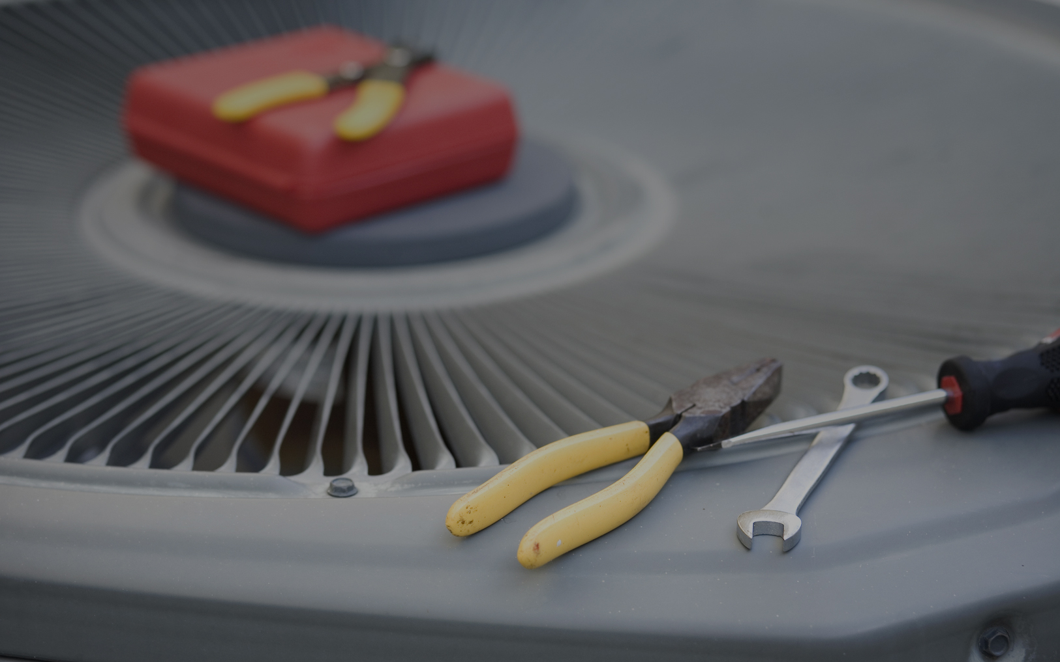


Power Your Career
Refrigeration Fundamentals

Slide 2


Refrigeration Fundamentals
Objective
Become familiar with the refrigeration cycle process.
Understand concepts such as Change of State, Heat Transfer, and Refrigerant.
Learn how all three work together in an AC system to remove heat from the home.
Need edits/formatting

Slide 3
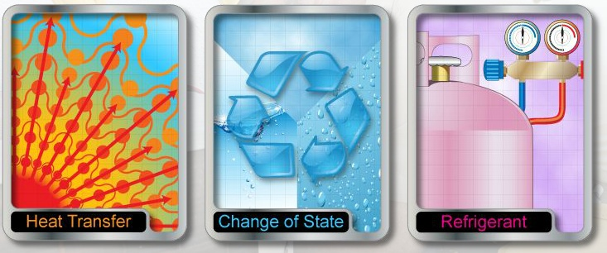
Refrigeration Fundamentals
Key Principles
Notes:
Here are some of the principles that, as a service technician, you need to be aware of:
heat transfer
change of state
refrigerant

Slide 4
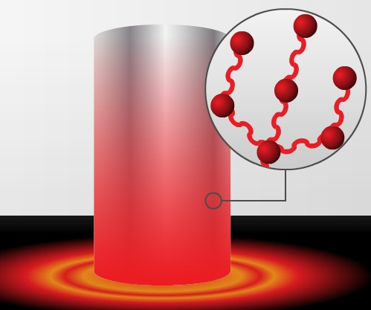
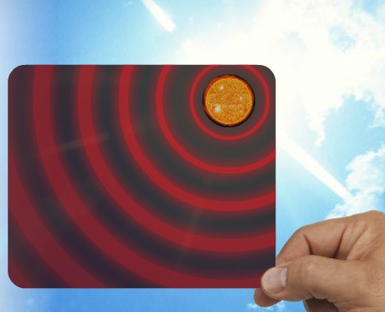
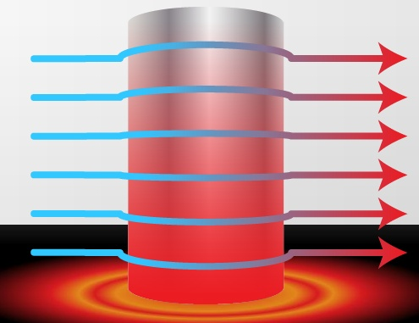
Refrigeration Fundamentals
Heat Transfer
Heat transfer methods
Heat is a form of energy
Heat transfer refers to how heat moves
Convection
Conduction
Radiant
Notes:
Heat is a form of energy. Heat transfer refers to how heat moves into substances and out of substances. Heat always flows from a hotter area to a cooler area. Three methods of heat transfer are:
conduction - how heat moves through solid object like a wall, or in the example picture, an iron rod; heat moves to the colder iron bar, moving particle to particle
convection - heat is transferred through a flowing medium like air or fluid, such as water; in this example, as air travels across the iron bar, some heat is transferred to the air
radiant - the sun’s rays heat objects with radiant waves similar to light but they cannot be seen

Slide 5
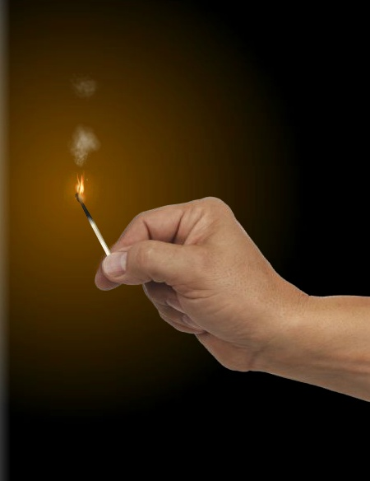
Refrigeration Fundamentals
Heat Transfer
Measured in BTUs
BTU – British Thermal Unit
A unit of measurement used to describe how machines and systems manage heat
BTU
1 lb H₂O
+1°
Notes:
When heat is added to a substance, that can raise its temperature, causing the state to change. Heat transfer is commonly measured in terms of British thermal units or BTUs. A BTU is defined as the amount of heat required to raise 1 pound of water 1°F. For example, one wooden kitchen match equals 1 BTU.

Slide 6
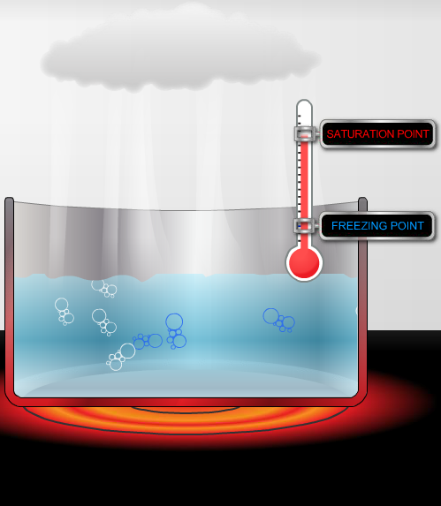
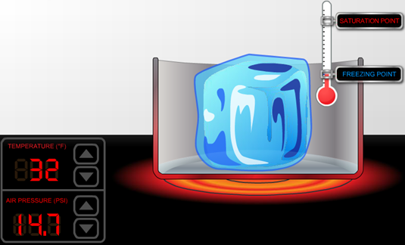
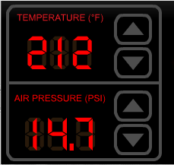
Refrigeration Fundamentals
Change of State
Definitions
Saturation Point:
When a substance changes from liquid to vapor, or vapor to liquid
Evaporation: Liquid Vapor
Condensation: Vapor Liquid
Notes:
The change of state is one of the most important principles in the refrigeration cycle. A change of state happens as heat moves into and out of objects. Here’s an example using a metal pot on a stove: the heat from the stove top warms the metal pot via conduction. The heat from the pot transfers to the ice, raising the temperature to the freezing point of 32°F (0°C). Once the temperature hits the freezing point, the ice will begin to melt. Note that the ice will continue to melt even if the temperature stays at 32°. This is due to latent heat, also known as hidden heat. As the heat continues to rise, the water will reach its saturation point of 212°F (100°C). Saturation point is when a substance changes from a liquid to a vapor or from a vapor to a liquid. When a substance changes from a liquid to a vapor, it's called evaporation. (The saturation point is also known as the evaporation point or the boiling point.) Once the substance reaches the saturation point, it will continue to change from a liquid to vapor even if the temperature does not continue to rise. As the temperature drops below the saturation point, heat transfers out of the vapor via convection. This results in the vapor returning the water to a liquid state, which is called condensation. In this case, the saturation point is also known as the condensing point. Pressure plays an important role in determining at what temperature change of state will occur. As pressure increases, so does the saturation point. As pressure decreases, so does the saturation point. In the previous example, we've seen how water state is affected by temperature and pressure. The same principles also apply to refrigerant.

Slide 7
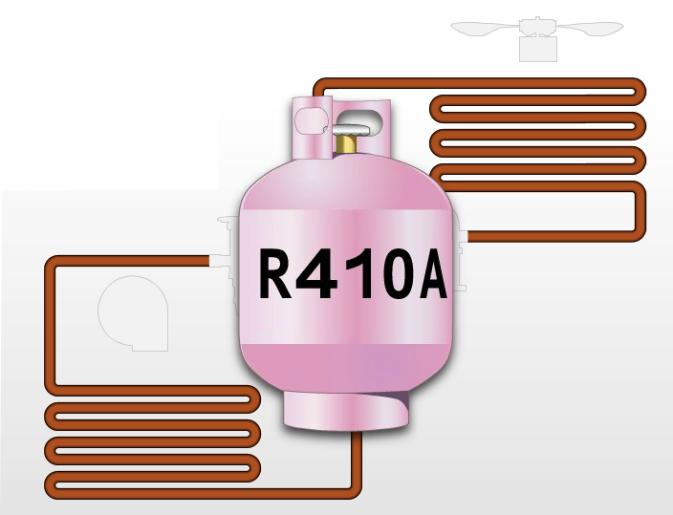
Refrigeration Fundamentals
Refrigerant (R-410A)
Notes:
Refrigerant is the substance that cycles through the air-conditioning system over and over again, and just as in the previous example with water, pressure and temperature affect the state of the refrigerant.

Slide 8
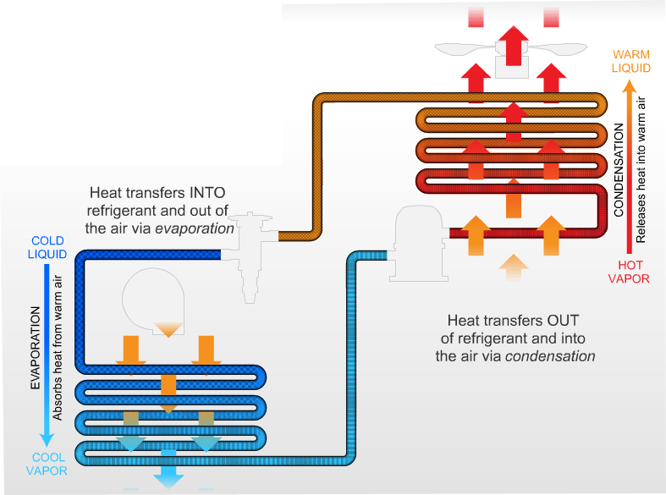
Refrigeration Fundamentals
Refrigerant
Notes:
Refrigerant inside the air conditioning system coils is under constant pressure. As the pressure rises, the refrigerant temperature and saturation point rises; as the pressure falls, refrigerant temperature and saturation point fall. These changes in pressure result in a change of state in the refrigerant. The change of state allows the refrigerant to be able to transfer heat. Large amounts of heat are transferred into the refrigerant as the refrigerant changes states through evaporation. One of the reasons that refrigerant works so well in this process is that it has a relatively low saturation point; for example, R-410A, a refrigerant at a pressure of 130 psig, has a saturation point of 45°F (7.2°C). Large amounts of heat are transferred into the refrigerant as the refrigerant changes state by evaporating, changing from liquid to vapor. Likewise, large amounts of heat are transferred out of the refrigerant as the refrigerant changes state by condensing. It is during these changes of state that the refrigerant is doing its hardest work because the largest and most efficient heat transfer takes place during the change of state.

Slide 9
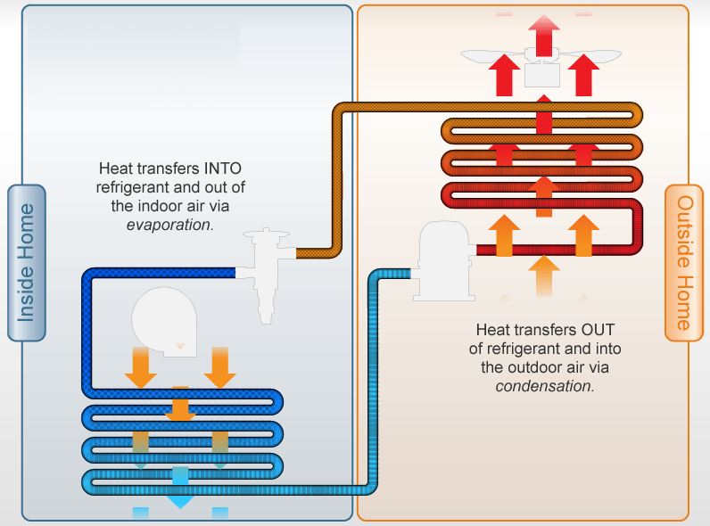
Refrigeration Fundamentals
Putting it Together
Notes:
Let's put the key principles together to see how they work in the refrigeration cycle. As refrigerant passes into the evaporator coil, it is a low temperature, low pressure liquid. The heat in the air is attracted to the low temperature of the refrigerant inside the coil. When the heat transfers into the refrigerant, this is what initiates the change of state from liquid to vapor. The superheated low-pressure vapor leaves the evaporator and enters the vapor line. The refrigerant travels outside the house where the heat is transferred from the hotter compressed refrigerant to the cooler outside air. The heat in the hotter, superheated vapor inside the condenser coil is attracted to the hot air outside, which initiates the change of state. The superheated vapor then becomes a liquid and the refrigerant then returns to the house to start the process all over again. Remember that heat always flows from a warmer body to a cooler body. Although it may seem as if the air-conditioner is adding cool air to the home, what's actually happening is that the air-conditioner is transferring heat from the inside of the home to the outside, using refrigerant to transport the heat. We can measure the amount of heat transferred out of the house in terms of British Thermal Units, or BTUs.

Slide 10
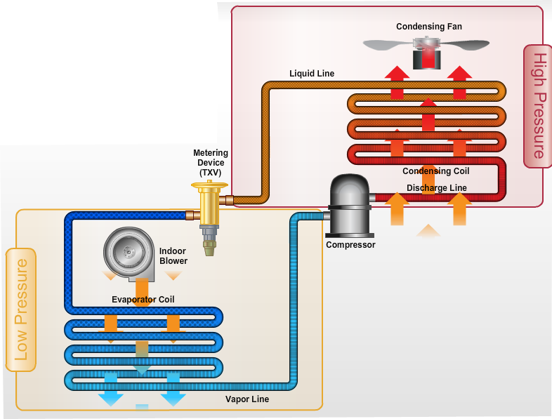
Refrigeration Fundamentals
Parts of the System
Notes:
Let's review the major components of the system, starting with the evaporator coil inside the home.
The refrigerant inside the evaporator coil starts as a cold, low-pressure liquid that evaporates into a cool low-pressure vapor by absorbing the heat from the indoor air.
The cooled, low-pressure gas refrigerant travels outside the home via the vapor line; the vapor line then carries the cool, low-pressure vapor refrigerant into the outdoor unit compressor.
The compressor takes the cool, low-pressure vapor and squeezes it, creating a very hot high-pressure vapor. The hot, high-pressure vapor refrigerant is forced through the discharge line; the discharge line carries the hot high-pressure vapor refrigerant into the condensing coil.
In the condensing coil, the hot high-pressure vapor refrigerant condenses into a warm high-pressure liquid by releasing the indoor air heat into the outside air. The outside air is pulled across the condensing coil by the condensing fan.
The warm, high-pressure liquid refrigerant exits the condensing coil through the liquid line. The liquid line carries the warm high-pressure liquid refrigerant back into the house and into the metering device.
The metering device controls the release of warm, high-pressure liquid refrigerant into a low-pressure line. There is a pressure restriction when the liquid hits the metering device that causes the warm, high-pressure liquid refrigerant to rapidly cool into a cold low-pressure liquid.
The cold, low-pressure liquid finally returns to the evaporator coil. The indoor blower forces warm indoor air across the evaporator coil and the refrigeration cycle begins again.

Slide 11
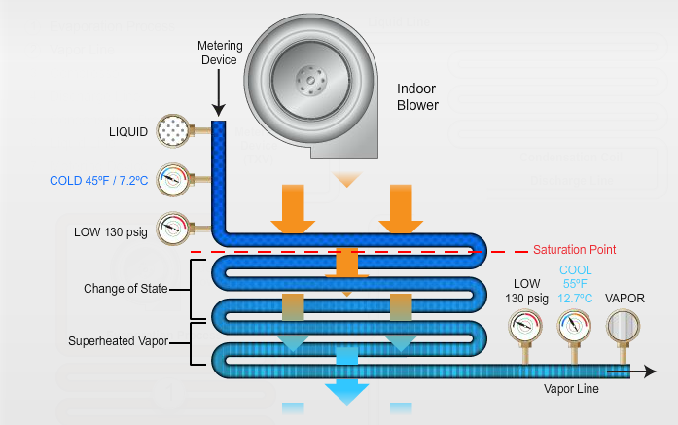
Refrigeration Fundamentals
Exploring the Refrigeration Cycle
The Evaporation Process
Notes:
Let's explore the refrigeration cycle in detail.
The first part of the refrigeration cycle is the evaporation process and the main piece of equipment is the evaporator coil. After leaving the metering device, refrigerant in the evaporator coil is a cold, low-pressure liquid. Anytime refrigerant encounters a restriction, as it does in a metering device, the pressure and the temperature are lowered. As a result, tiny vapor bubbles form in the refrigerant because of the drastic change in pressure; the formation of these vapor bubbles is commonly known as flashing. As the refrigerant travels through and leaves the evaporator coil, its state has changed to a superheated low-pressure vapor. The purpose of the evaporator process is to transfer heat from the house to the refrigerant as warm air from the house passes over the evaporator coil assisted by an indoor blower fan. Heat is transferred into the refrigerant; this causes the refrigerant to boil or evaporate. It has been loaded up with heat during the change of state, and now it has to travel outside to dump it out. Meanwhile the air from the house is now cool indicating an absence of BTUs, and it cycles back into the house to bring the temperature down to a cool, comfortable level.

Slide 12
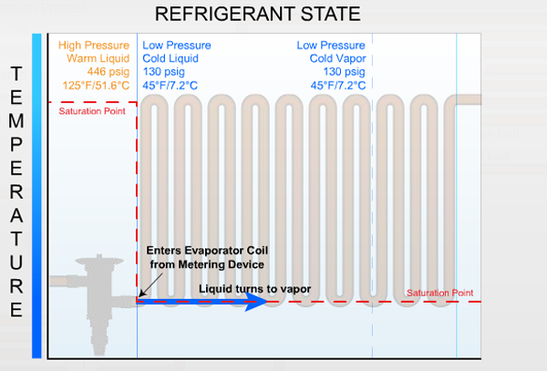
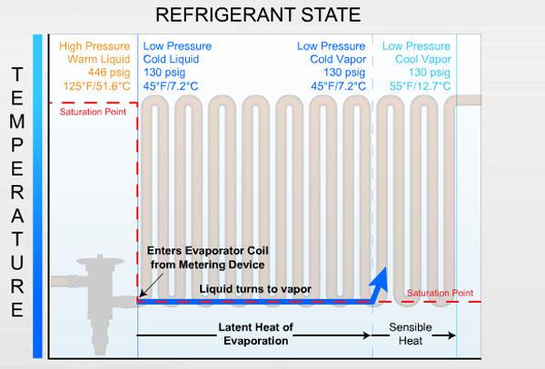
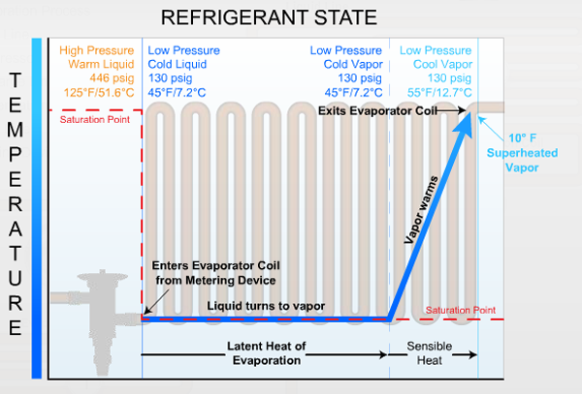
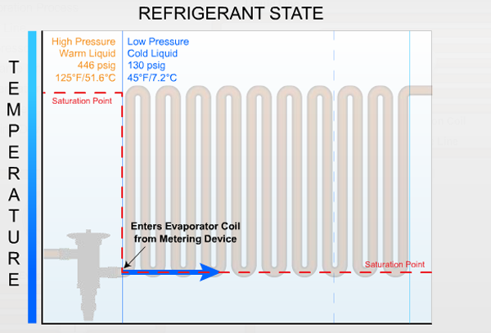
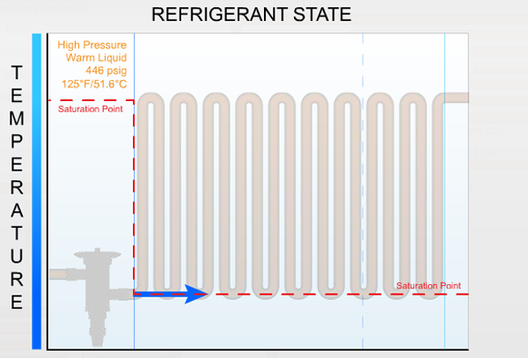
Refrigeration Fundamentals
Exploring the Refrigeration Cycle
The Evaporation Process
Notes:
Now take a closer look at what happens as the refrigerant passes through the evaporator coil.
[CLICK TO ADVANCE IMAGE]
After it leaves the metering device, refrigerant enters the evaporator process as a cold low-pressure liquid.
[CLICK TO ADVANCE IMAGE]
As it absorbs the heat from the air in the house, refrigerant changes state from a liquid to a vapor. The most efficient heat transfer occurs with the change of state so this is a critical moment in the refrigeration cycle; it is this change of state that allows the refrigerant to absorb large amounts of heat.
The temperature of the refrigerant does not rise during the change of state; all of the heat is used to convert the liquid to a vapor. We refer to this heat as the latent heat of evaporation.
[CLICK TO ADVANCE IMAGE]
After the last drop of refrigerant has turned to gas, it still has a few coils of the evaporator that it must pass through; any additional heat that it absorbs will increase the temperature of the vapor.
[CLICK TO ADVANCE IMAGE]
Finally, the superheated low-pressure vapor leaves the evaporation coil and enters the vapor line.

Slide 13
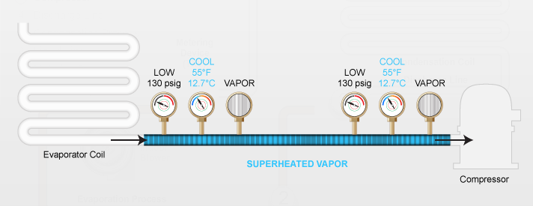
Refrigeration Fundamentals
Exploring the Refrigeration Cycle
The Vapor Line
Notes:
In the vapor line no heat transfer takes place. The refrigerant enters the vapor line as a superheated low-pressure vapor and it exits the suction line in the same way. The purpose of the vapor line is to transport the superheated vapor from the evaporator to the compressor.

Slide 14
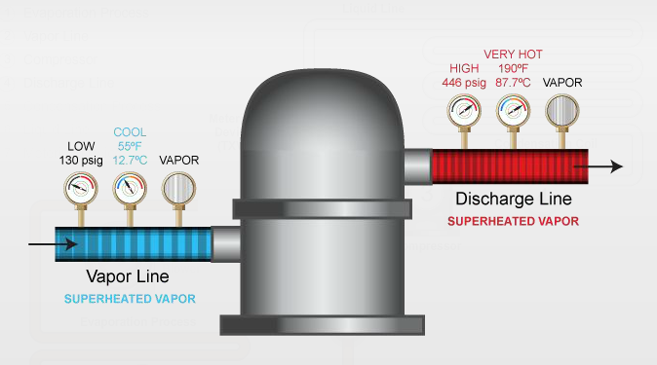
Refrigeration Fundamentals
Exploring the Refrigeration Cycle
The Compression Process
Notes:
Refrigerant enters the compressor as a low-pressure superheated vapor. When it leaves the compressor it is a high pressure, very hot superheated vapor; the act of compressing the vapor also adds some additional heat so the refrigerant is now even hotter than before it entered the compressor. The job of the compressor is to increase the pressure and the saturation point of the refrigerant by “squashing” it.

Slide 15
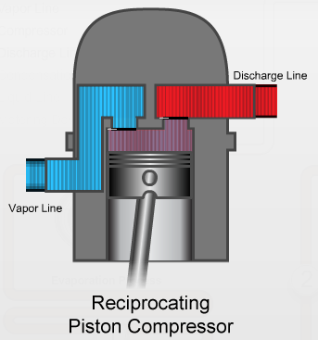
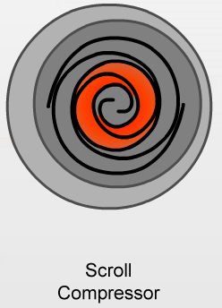
Refrigeration Fundamentals
Exploring the Refrigeration Cycle
Two Types of Compressors
Reciprocating Piston Compressor
Scroll Compressor
Notes:
There are two types of compressors commonly used in HVAC equipment. The reciprocating piston type compressor is one type of compressor. The piston retracts to allow low-pressure vapor to enter the compressor from the vapor line; as the piston returns, the vapor is pressurized and it leaves the compressor to go into the discharge line. Residential high-efficiency HVAC equipment often have scroll compressors. In a scroll compressor, low-pressure vapor enters the scroll compressor on the outer rim of the scroll. As the refrigerant vapor moves toward the center of the scroll, the area is reduced, increasing its pressure. By the time the vapor reaches the center of the scroll, it is at its highest pressure and leaves the compressor to go into the discharge line.

Slide 16
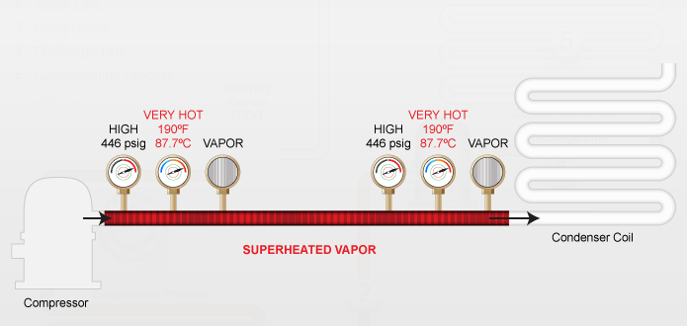
Refrigeration Fundamentals
Exploring the Refrigeration Cycle
The Discharge Line
Notes:
In the discharge line, no heat transfer takes place. Very hot, superheated high-pressure vapor enters the discharge line from the compressor and it remains in that state as it travels through the discharge line. The purpose of the discharge line is to transport the refrigerant from the compressor to the condenser.

Slide 17
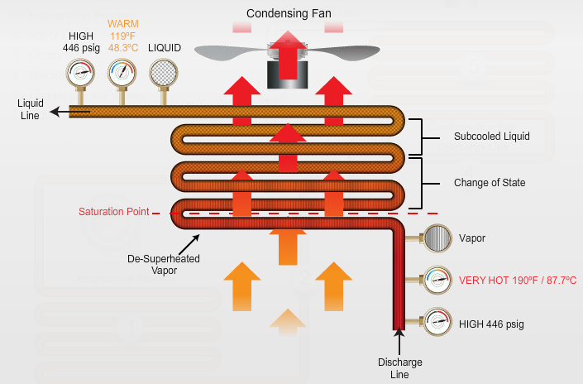
Refrigeration Fundamentals
Exploring the Refrigeration Cycle
The Condensation Process
Notes:
When refrigerant enters the condenser coil, it is a superheated, very hot, high-pressure vapor. This is the hottest point in the refrigeration cycle because the refrigerant is loaded up with the heat in the evaporator coil as well as the heat of compression. When the refrigerant leaves the condenser coil, it is a warm, high-pressure liquid. The refrigerant has just been pressurized in the compressor and its saturation temperature went up as pressure went up. Now, even on a hot summer day, its saturation point is higher than the outside temperature. The condenser is where the refrigerant gives up its heat and transfers it to the outside air; as outside air blows over the condenser coils, the temperature of the refrigerant begins to fall. When it is cooled down to its saturation point, it condenses back to a liquid that continues to cool until it reaches the last coil; no vapor remains - it is completely liquefied.

Slide 18
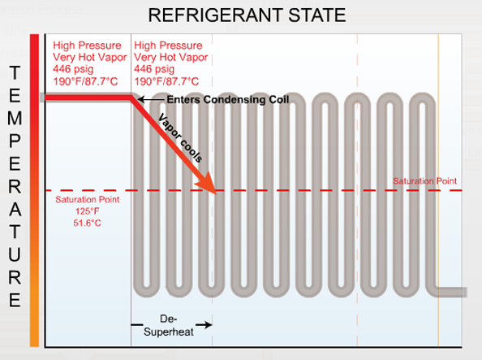
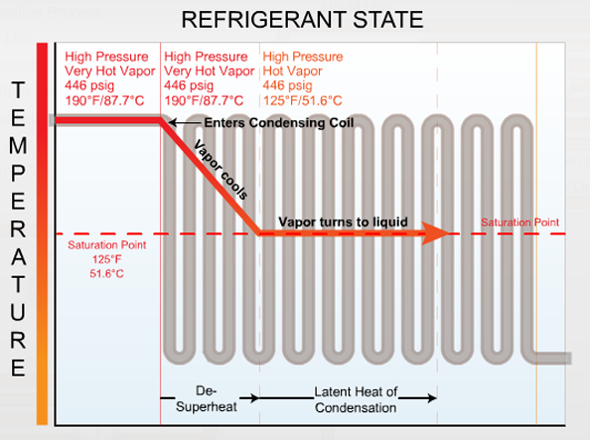
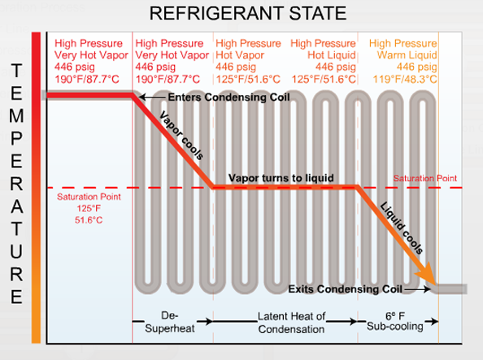
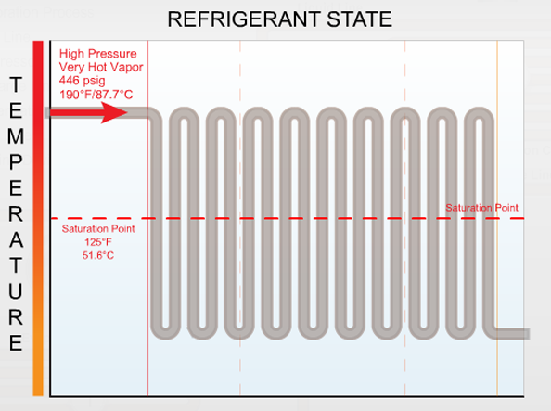
Refrigeration Fundamentals
Exploring the Refrigeration Cycle
The Condensation Process
Notes:
The condensation process is where refrigerant gives up its heat to the outside air. The condenser fan helps to transfer more heat away by blowing outside air over the condenser coils.
[CLICK TO ADVANCE IMAGE]
Refrigerant enters the condenser as a very hot, superheated vapor and can't begin the condensation process until it drops to the saturation condensing point, so first it goes through a de-superheated stage.
[CLICK TO ADVANCE IMAGE]
After the gas has been cooled down to the saturation point, refrigerant begins to condense. Since the most efficient heat transfer occurs with the change of state, this is a crucial moment in the refrigeration cycle. This is where the majority of the heat is removed from refrigerant during condensation. The temperature of the refrigerant stays the same. We refer to the heat energy that is removed from the refrigerant as the latent heat of condensation.
[CLICK TO ADVANCE IMAGE]
After all the refrigerant has been turned back into a liquid, it continues to cool as it passes through the last few coils of the condenser; this process causes the temperature of the liquid to fall and is called sub cooling.

Slide 19
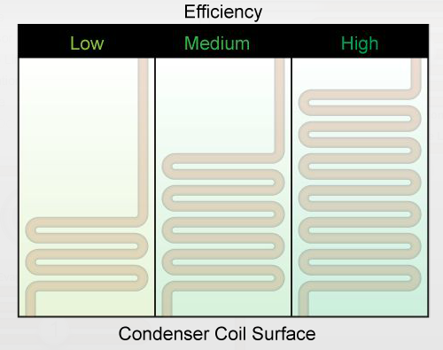
Refrigeration Fundamentals
Exploring the Refrigeration Cycle
Condenser Efficiency
Notes:
One of the continuous challenges in the HVAC industry is to design and build higher efficiency air conditioning systems. There are many factors that contribute to increased efficiency systems, but the best way to gain efficiency is by enlarging the size of the condenser coil surface. Enlarging the condenser coil surface allows more cooling to take place inside the condenser, which ultimately means that the system requires less power to operate.

Slide 20
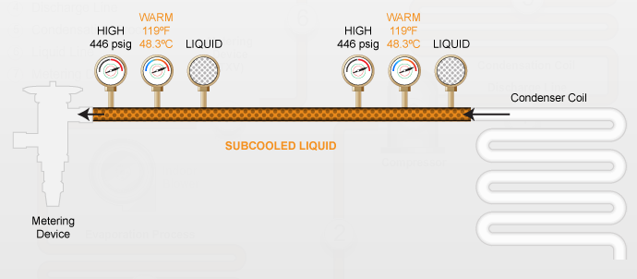
Refrigeration Fundamentals
Exploring the Refrigeration Cycle
The Liquid Line
Notes:
No heat transfer takes place in the liquid line. It contains warm, or sub cooled, high-pressure liquid. The purpose of the liquid line is to transport liquid refrigerant to the metering device.

Slide 21
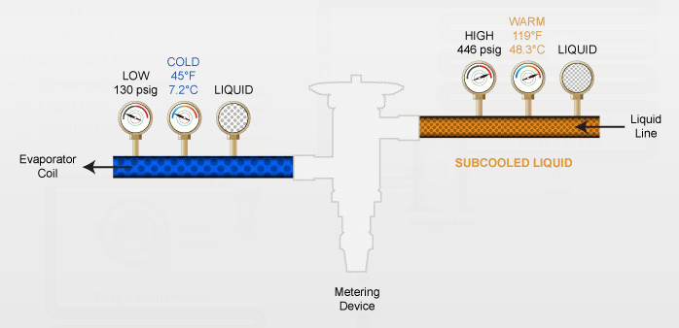
Refrigeration Fundamentals
Exploring the Refrigeration Cycle
The Metering Device
Notes:
The metering device does two things. First, it takes the sub cooled, high-pressure liquid refrigerant from the liquid line and releases it as low-pressure liquid into the evaporator. Remember, lowering the pressure will lower the boiling point, thereby preparing the refrigerant for the evaporator process. The metering device also regulates the amount of refrigerant entering the system. On a hot day when the thermostat is turned down very low, more refrigerant is required. On other days when the outside temperature is not so hot, less refrigerant is required. The metering device regulates the flow of refrigerant to match the load.

Slide 22
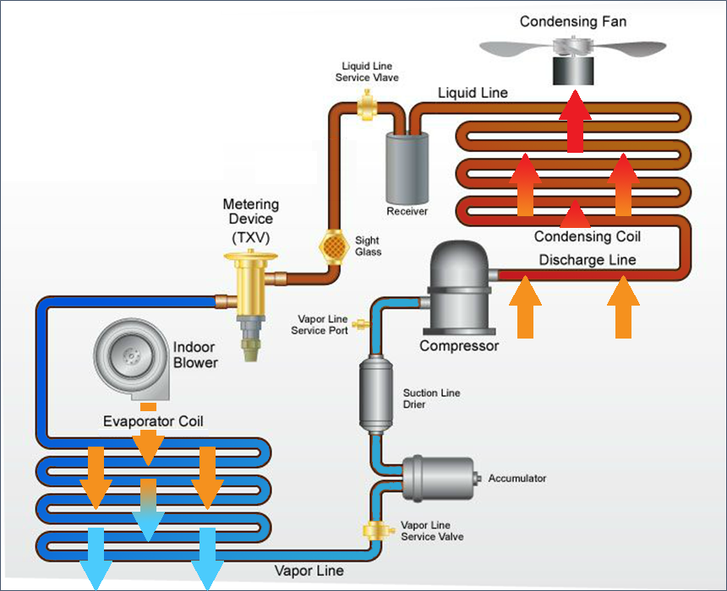
Refrigeration Fundamentals
Exploring the Refrigeration Cycle
Additional Equipment
Notes:
If you examine your air conditioning system you may see some additional equipment. On the vapor line you may find an accumulator and a suction line dryer; these pieces of equipment help to keep the gas dry before it enters the compressor because moisture can damage the compressor. On the liquid line you may find a receiver and sight glass; you may also find various service valves.

